Slide 1
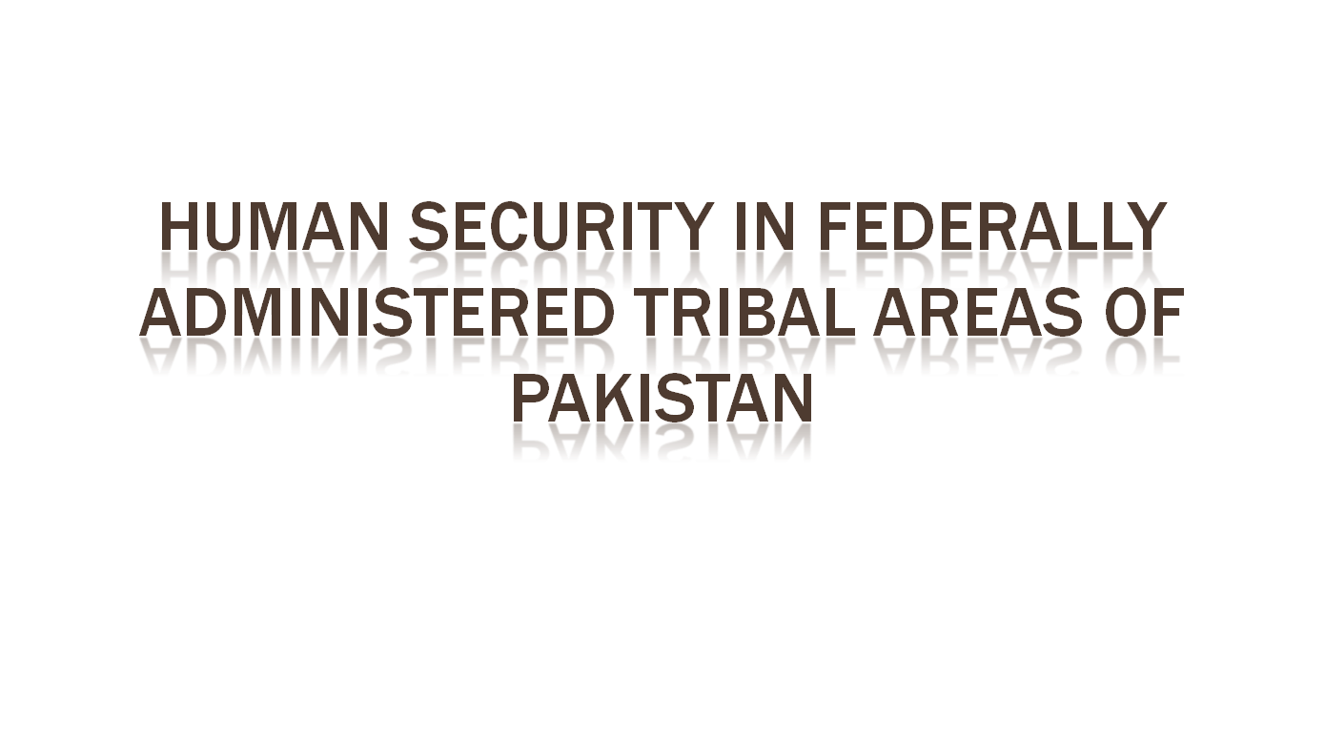

Slide 2

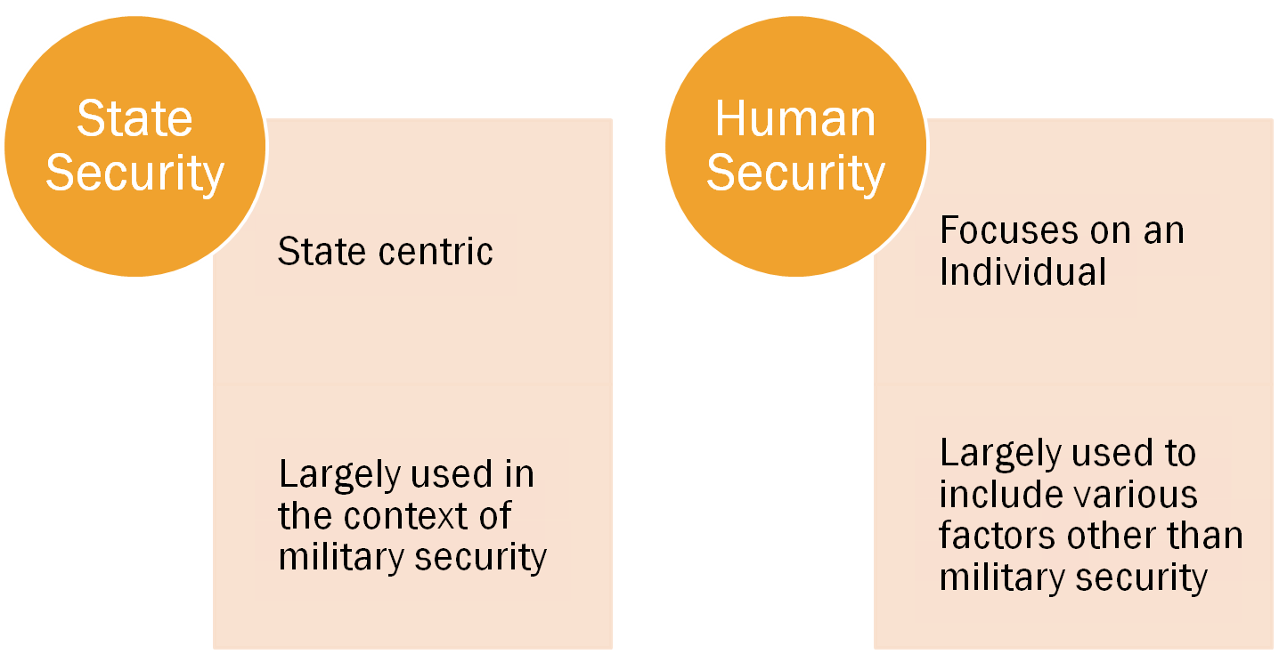

Slide 3

The macro level state-centric security was considered too mechanical approach
It was challenged by the growing currents of globalization and resultant transnational issues common to multiple states like environment, democratization and civil liberties, human rights, droughts, epidemics and other diseases, poverty and terrorism etc

Slide 4

Relatively new concept, Human Security, has gained currency in modern discourse in Security Studies. Concept of Human Security is derived primarily from the Human Development.
At global level, the concept of human security was introduced after the two Global Wars that killed hundreds of thousands people.

Slide 5

In June 1945, US Secretary of State, in his official report to the US government states:
“The battle of peace has to be fought on two fronts. The first is the security front where victory spells freedom from fear. The second is the economic and social front where victory means freedom from want. Only victory on both fronts can assure the world of an enduring peace…. No Provisions that can be written into the Charter will enable the Security Council to make the world secure from war if men and women have no security in their homes and their jobs.” (UNDP, 1994)

Slide 6
The statement represents the understanding of dangers to humanity. Traditionally this danger was considered to be emanating from violence/military aggression as has been referred to as ‘fear’. Freedom from this ‘fear’ was considered one aspect of security.
A new dimension in post-World War Two about security was developed and named as freedom from ‘want’ related to social and economic front. This clearly implies the freedom from basic necessities of life.
Freedom from want was referred to as a new challenge to the security of an individual. However, the advent of Cold War and obsession of global political actors with traditional security against opposite camps, the idea could not flourish much.

Slide 7

United Nations Development Program’s Human Development Report of 1994 is the pioneering document highlighting the concept and its significance.
The report has tried to alter the traditional concept of Security and emphasized that focus of UN and states’ efforts should be human security at micro level rather than at traditional security through arms. The focus of the report on individual is highlighted as:
“In the final analysis, human security is a child who did not die, a disease that did not spread, a job that was not cut, an ethnic tension that did not explode in violence, a dissident who was not silenced. Human security is not a concern with weapons – it is a concern with human life and dignity.”(UNDP, 1994)

Slide 8

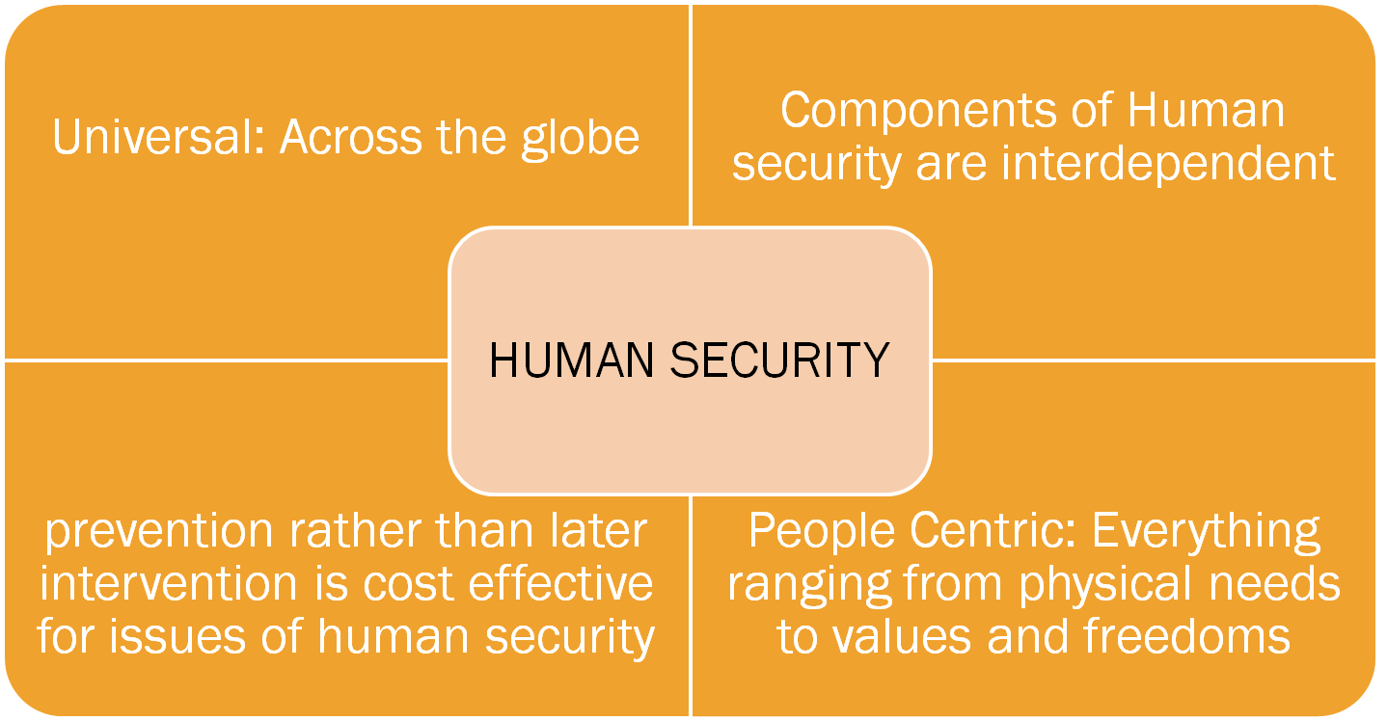

Slide 9

Economic
Food
Health
Environmental
Personal
Community
Political

Slide 10

FATA has always served as the key component of Pakistan’s security policy in the region.
The state’s security policy in FATA has been part of broad National Security Policy viz a viz India.
However, FATA suffered more than other parts of Pakistan mainly because of the difference in governance structures (whatever they are).
It is thus argued here that key link (human security) between state and the citizens have been weakened over the period of time due to above stated reason.

Slide 11
Here Reza Rumi’s concept of 'ungoverned' spaces in FATA is largely misunderstood. The region was largely left on its own to develop and govern themselves without any state apparatus on ground.
Whatever ground apparatus state has is meant to punish and not to provide basic necessities necessaties.
Every society has some sort of social code, however, the people in a society need more than just social code. It is this reason that gave birth to the very state system.

Slide 12

It is ironic and sad that the key threats to the political security of the people in FATA come not from militants but from the state.
Absence of Political Parties Act, continuing with FCR and the political governance are some of the examples in this regard.
However, militants also pose threat to political security of the people by establishing parallel governments, threatening those who participate in political activities etc.

Slide 13

The threats to economic security of people in FATA also are largely associated with state complicity or inability for (under)development of the region.
Historically there was no industrialization except for in very few pockets in FATA. Whatever existed has been badly affected by the decade old war.
Long curfew hours in the towns in FATA always lead to the closure of markets for days thus hitting very hard to the people whose bread and butter depend on their daily earnings.
According to some estimates, the unemployment is as low as 68 %. The conflict has only increased the number.

Slide 14

The tribesmen in FATA face personal physical security threats from militants, military operations, drones, sectarian violence and feudal conflicts to name few.
There are very few studies on domestic violence for the women in FATA. However, some reports suggest the domestic violence at alarmingly higher level.

Slide 15

To conclude, the remedy to people of FATA can come only from the state.
There is debate in researchers and scholars on the delicate balance between development and security, however, in the context of FATA, the state claims to have achieved the ‘minimum security’ and now development part is much awaited.
If state ensures human security to the people, particularly political, economic and social security, peoples' perception about state is more likely to change.
This trust on state will be a real catalyst for bringing major changes in Legal, political and administrative reforms in order to bring FATA in national mainstream.
Any attempt at coercing people to change their pattern of thinking has and will fail
Finally, a new Social Contract is required to reestablish state-society link which should not impose unilateral impose conditions on the people the way it is being done to IDPs returning home in NWA.

